Slide 1
1 meter of elevation head
1 meter
Reference elevation
1 meter of pressure head
1 meter of velocity head

Slide 2
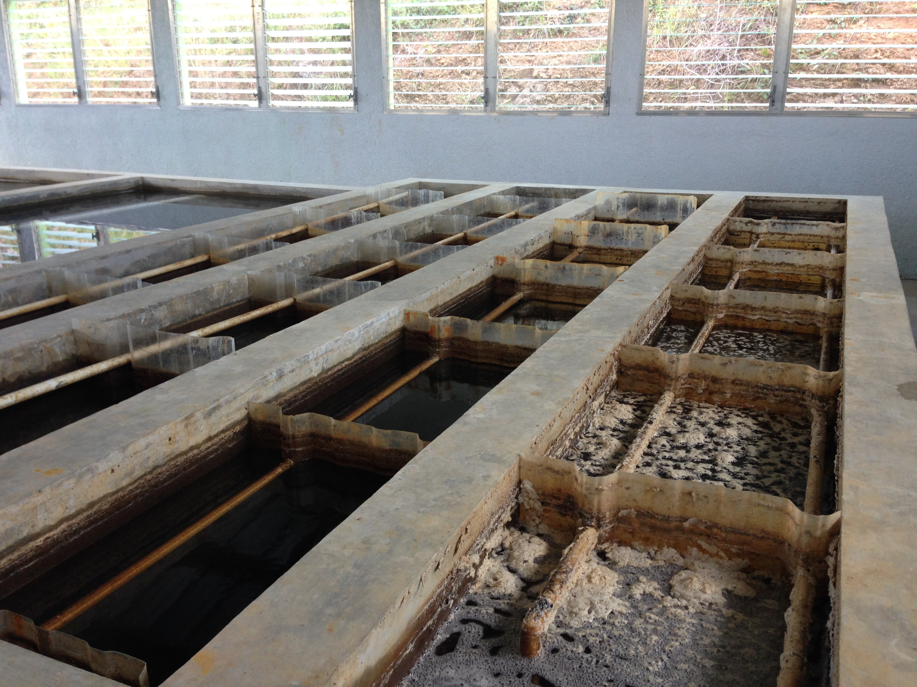
AguaClara Flocculator
Top Baffles
Bottom Baffles, underwater

Slide 3
AguaClara Flocculator

Slide 4
AguaClara Flocculator
AguaClara Flocculator
Top Baffles
Bottom Baffles, underwater

Slide 5
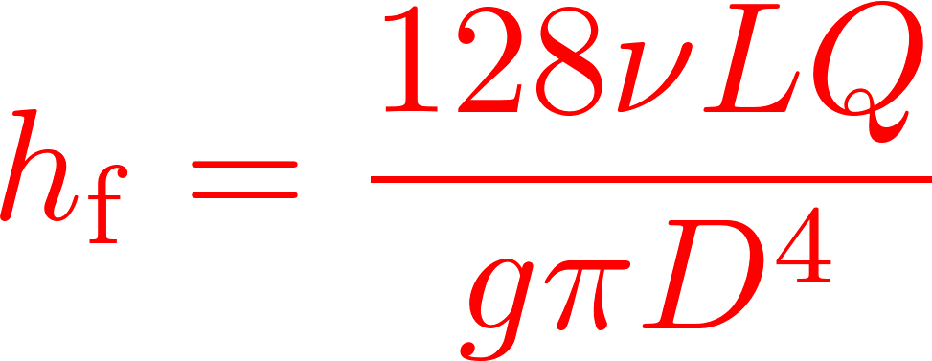
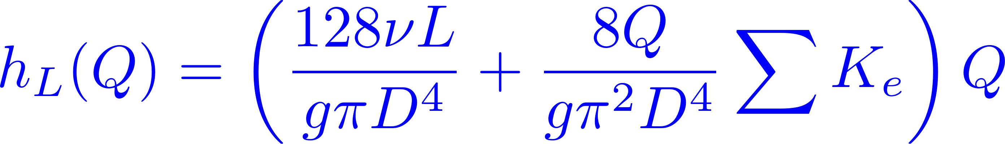

Calibrate at max flow

Slide 6
Baffles
Baffle

Slide 7
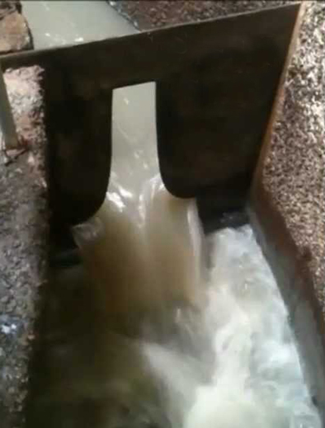
Sutro Weir
LFOM

Slide 8

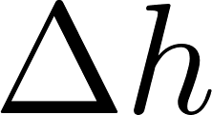


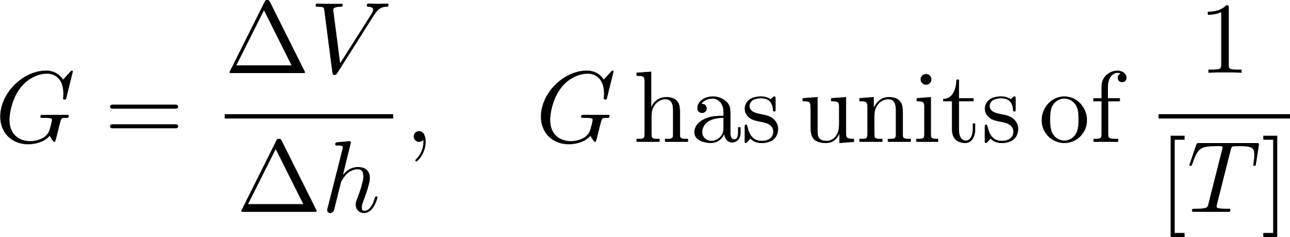

Slide 9

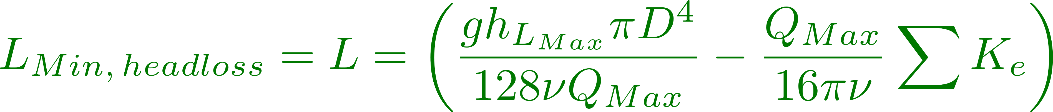

Slide 10
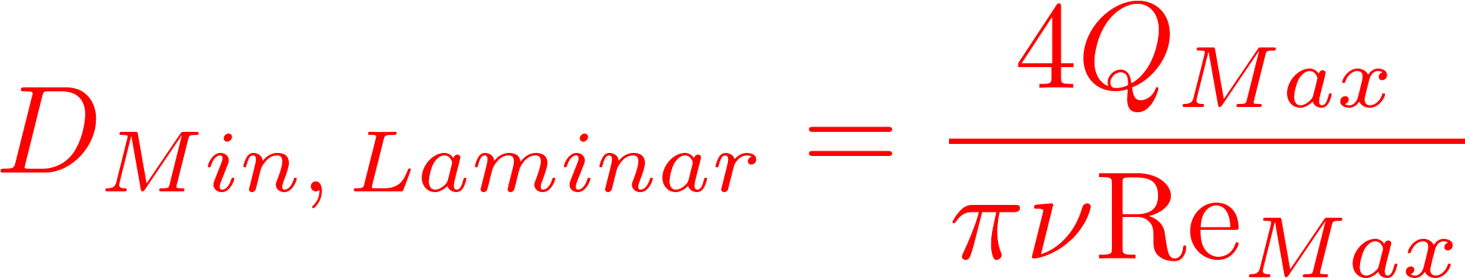
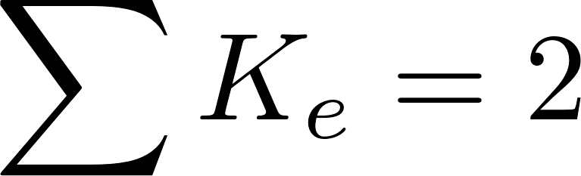
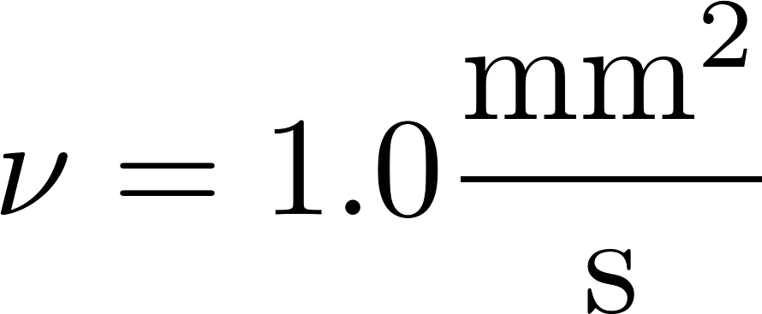
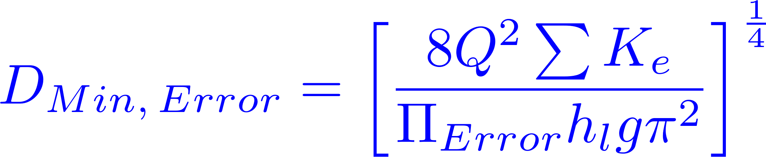
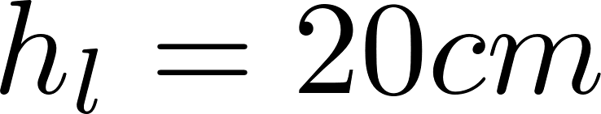
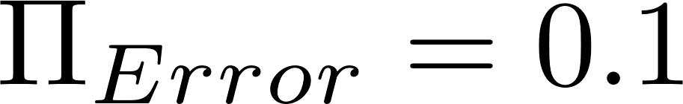

Slide 11
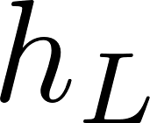
Small diameter tubing

Slide 12
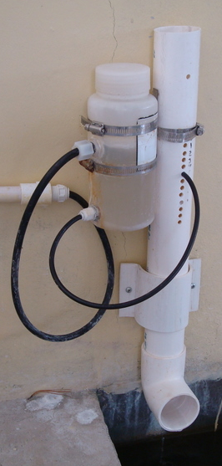
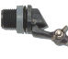
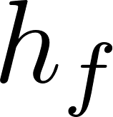
Air vent
Tube from the stock tank
Float valve
Holes to choose the dose
Flexible tube
Raw water
Rapid Mix
Orifice

Slide 13
V_{in}
V_{out}
A_{in}
x
A_{out}
in
out

Slide 14
Horizontal orifice
Vertical orifice

Slide 15
Overhead Tank
Constant head orifice
Overflow pipe
Pump

Slide 16


A
B

Slide 17
Pipe stub
Pipe coupling
Drain piping

Slide 18
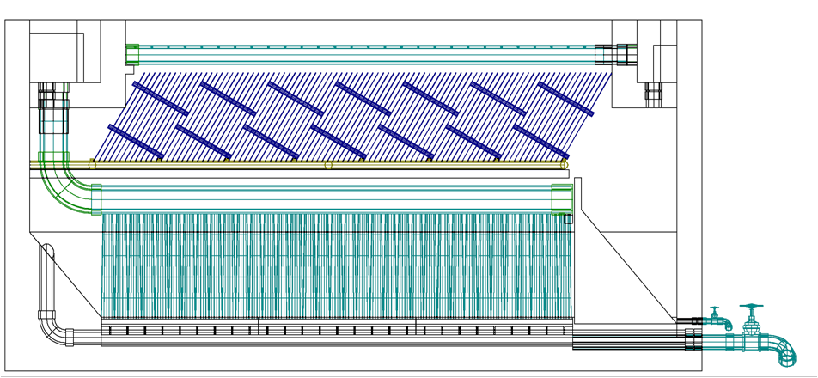
AutoCAD drawing of sedimentation tank, don’t worry if this is confusing!
You’ll learn about it in depth later on.
Sedimentation
tank drain

Slide 19


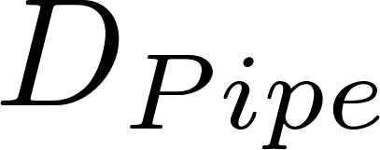
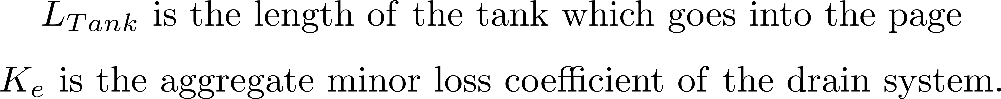

Slide 20
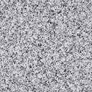
Float
Float
Orifice
Orifice
Transparent flexible tube
Transparent flexible tube

Slide 22
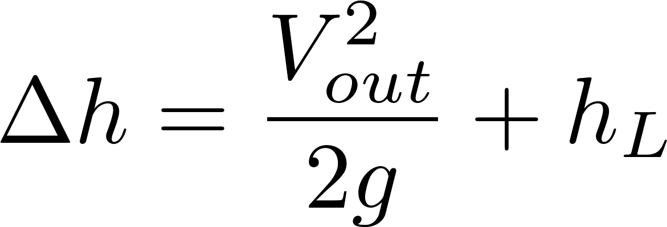
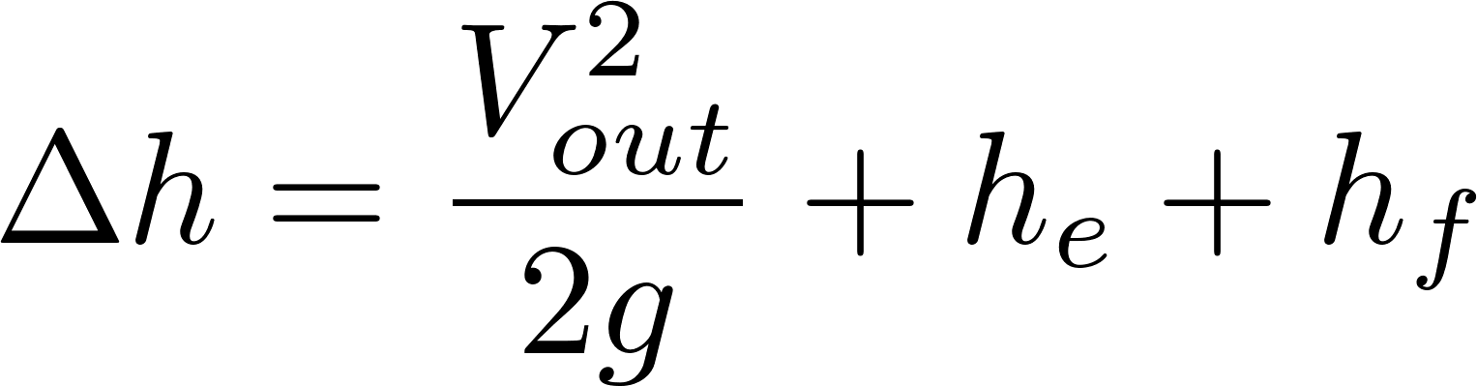
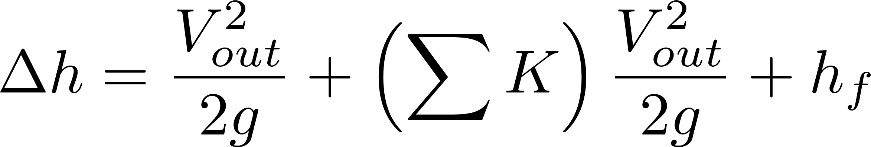
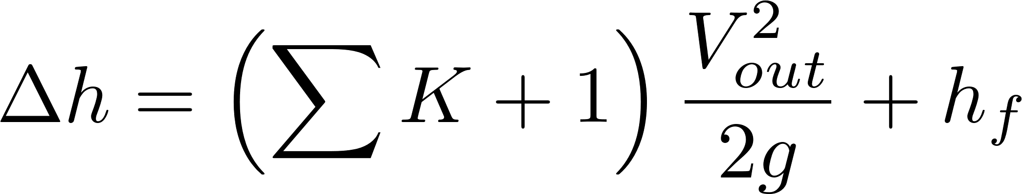
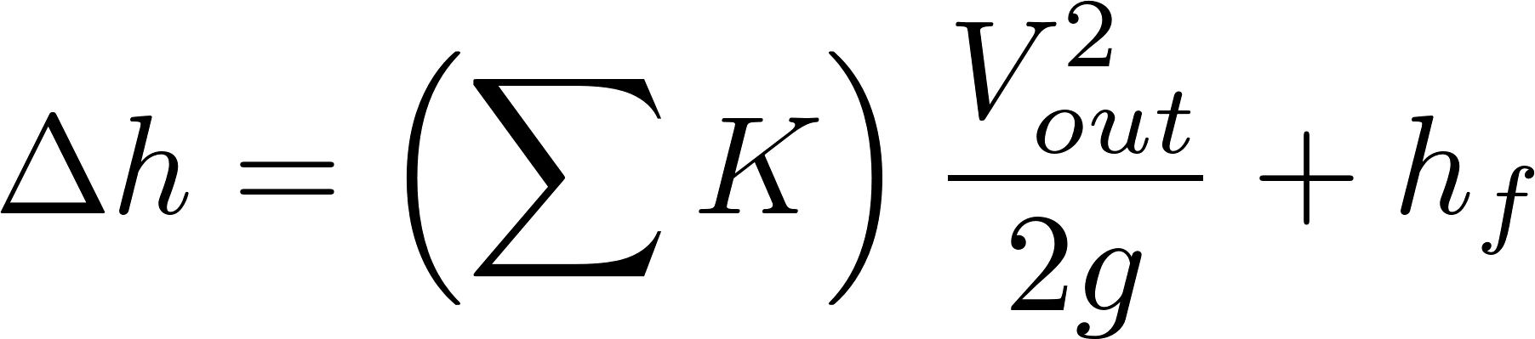
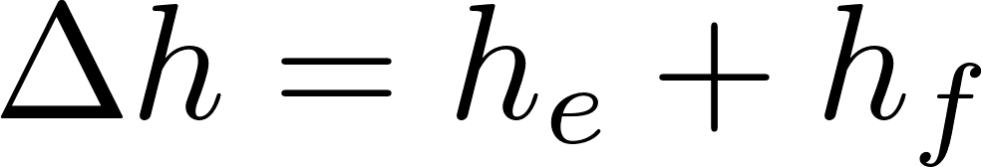

Simplified
energy equation
Just adding
K = 1 to the sum

Slide 23
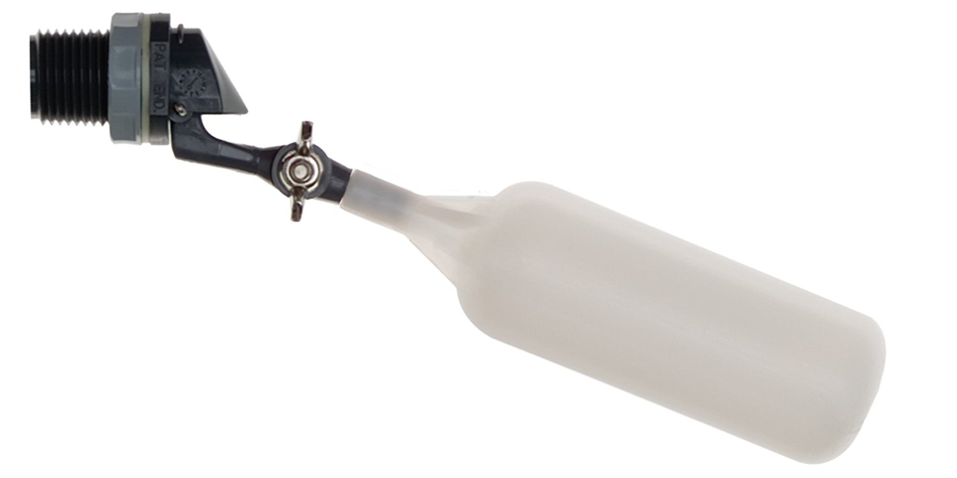
Flow of water
out of valve
Range of
motion of float
Float

Slide 24
C
B
A

Slide 25
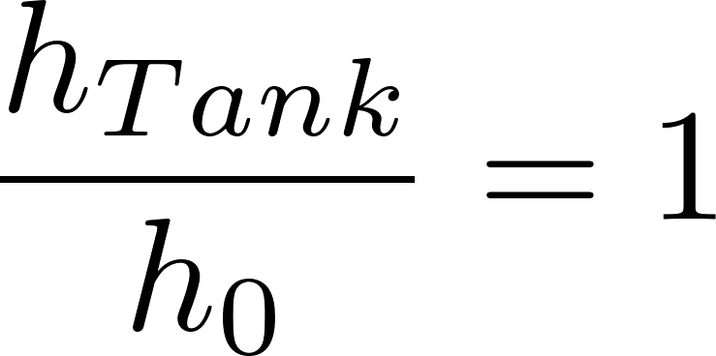
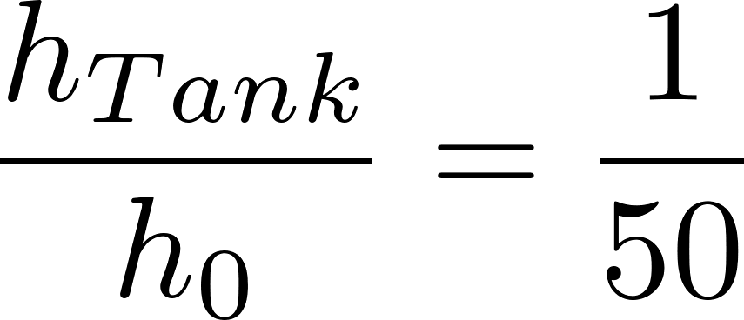
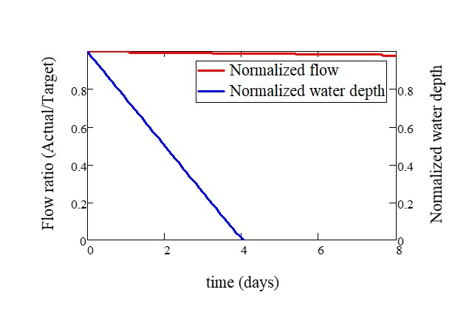
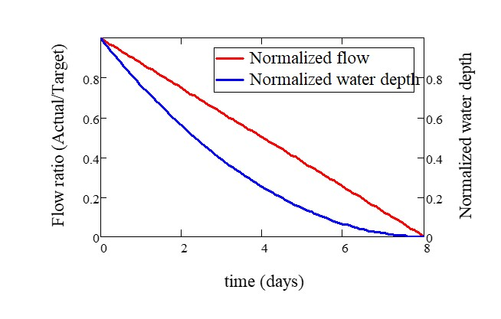

Slide 26

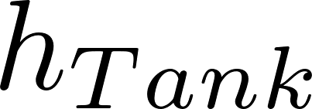
Tank
Valve
Water source pipe
Tank
Valve
Water source pipe

